Slide 1



Married:
Growing & Serving Together
A Study of Marriage, Spring 2023

Slide 2
A Quick Review of Our Intro from 1st Class
The Content
  A Study of Marriage – Seeking to Better Understand God’s Purpose for Marriage and to Improve Our Marriages through Study & Application
Basis: Primarily Scripture: rules & principles from the Architect of marriage
We can learn a great deal about marriage and male/female relations from the Bible – from God’s instructions governing marriage, good and bad examples, and things we can infer from God’s stated purposes for marriage.
The Bible begins and ends with weddings - from the marriage of Adam and Eve in Genesis 2 to the marriage of Christ and the church (the Lamb and His bride) in Revelation 19-22.
Marriage is part of one of three main human relationships instituted by God – the family, the church, and the state (civil government).
Marriage was designed by God, and the Bible is the “owner’s manual.”
If we ignore Scripture’s teaching on marriage, we are courting disaster.

Slide 3
Class Schedule

Slide 4
God’s Design for Marriage – Back to the Beginning
In Mt. 19:3, Jesus was questioned about the lawfulness of divorce.
Jesus answered by taking them back to the beginning and quoted Scripture from Genesis – “Have you not read...?”
  Matt. 19:4b: “that He who created them from the beginning MADE THEM MALE AND FEMALE (Gen. 1:27)
  5 and said, ‘FOR THIS REASON A MAN SHALL LEAVE HIS FATHER AND HIS MOTHER AND BE JOINED TO HIS WIFE, AND THE TWO SHALL BECOME ONE FLESH’? (Gen. 2:24)
  6 So they are no longer two, but one flesh. Therefore, what God has joined together, no person is to separate.”
So, we’ll begin our study of Bible texts on marriage where Jesus did – in Genesis 1 and 2.
Notes:
Also, Gen. 5:1b-2a: “When God created man, he made him in the likeness of God. Male and female he created them,

Slide 5
Genesis 1: God Created
And It Was Good
3 And God said, “Let there be light,” and there was light. 4 And God saw that the light was good.
10 God called the dry land Earth and the waters that were gathered together he called Seas. And God saw that it was good.
12 The earth brought forth vegetation, plants yielding seed according to their own kinds, and trees bearing fruit in which is their seed, each according to its kind. And God saw that it was good.
17 And God set them in the expanse of the heavens to give light on the earth, 18 to rule over the day and over the night, and to separate the light from the darkness. And God saw that it was good.
21 So God created the great sea creatures and every living creature that moves, with which the waters swarm, according to their kinds, and every winged bird according to its kind. And God saw that it was good.
25 And God made the beasts of the earth according to their kinds and the livestock according to their kinds, and everything that creeps on the ground according to its kind. And God saw that it was good.
31 And God saw everything that he had made, and behold, it was very good.
Genesis 2:18 And the LORD God said, “It is not good that man should be alone; I will make him a helper comparable to him.” (NKJV)
Was anything not good?
Notes:
God saw that the light he’d made was good.
The dry land and seas were separated and that was good.
The plants & trees created on Day 3 were good
The sun, moon, & stars created on Day 4 were good
Birds and fish made on Day 5 were good.
The land animals created on Day 6 were good
After God created man, He said everthing He had made was very good.

Slide 6
The Creation of Woman Was Not an Afterthought
There is no conflict between Genesis 1 & 2, just different perspectives.
The creation of mankind as male and female, the institution of marriage, and “filling the earth” through human procreation in marriage were all part of God’s plan from the beginning.
God knew that Adam would be in a “not good” condition even when he was in a perfect world with a perfect relationship with God. He designed us to need “horizontal” relationships with other humans in addition to a “vertical” relationship with Him.
God knew the man would not find the helper he needed among the animals, but the “parade” of animals for naming in 2:19-20 proved this to Adam as well.

Slide 7
Genesis 1 and 2 Compared & Contrasted
Genesis 1:1 – 2:3 | Genesis 2:4-25
Told from a “Cosmic” viewpoint | Told from Human viewpoint
Days 1-7 | Mostly Day 6
Orderly, chronological sequence | Ordered to support its purpose of emphasizing the creation of man and his relationship with the rest of creation
Broad focus | More detailed focus
True | True

Slide 8
What Was Special About the Creation of Mankind?
Man in Nature | Man Over Nature & Special
Made on Day 6 along with other land animals (1:24-31) | To rule and subdue the rest of creation (1:26, 1:28, Ps. 8:6-8)
Made from the dust along with the other living creatures (2:7,19) | Different nature / Needed more than animal companionship (2:20)
Fed on the vegetation as did other living things (1:29-30) | Made in the image and likeness of God (1:26-27)
Both man and animals had God’s blessing to “be fruitful and multiply and fill...”
So, what does this mean?

Slide 9
Gen. 1:26-27:
Man in God’s Image & Likeness
26 Then God said, Let Us make mankind in Our image, according to Our likeness; ... 27 So God created man in His own image, in the image of God He created him; male and female He created them.
A few unique characteristics of humans (not just males!):
Rule over creation
Self aware
Free-willed, rational beings
Capable of deep love
Desire relationships
Make plans and promises
Moral beings with a spiritual
nature
Possess an eternal soul
Mankind was made for marriage!

Slide 10
Gen. 1:26-27:
Man in God’s Image & Likeness
26 Then God said, Let Us make mankind in Our image, according to Our likeness; ... 27 So God created man in His own image, in the image of God He created him; male and female He created them.
A few unique characteristics of humans (not just males!):
Rule over creation
Self aware
Free-willed, rational beings
Capable of deep love
Desire relationships
Make plans and promises
Moral beings with a spiritual
nature
Possess an eternal soul
A male and a female, united as “one flesh” can, in some ways, be the best reflection of the image of the Godhead – distinct personalities that are inseparably united.
Notes:
This means that our maleness or our femaleness is not incidental to our humanness but constitutes its very essence. God does not make us into a generic humanity that is later differentiated; rather from the start we are male or female. This means I cannot understand myself if I try to ignore the way God has designed me or if I despise the gifts he may have given to help me fulfill my calling. If the postmodern view that gender is wholly a “social construct” were true, then we could follow whatever path seemed good to us. However, If our gender is at the heart of our nature, we lose a key part of ourselves if we abandon our distinctive male and female roles. (Keller)

Slide 11
Genesis 2: The Garden Paradise Before Sin
The garden was fertile and well-watered, filled with every kind of tree that was beautiful and bore fruit that was good to eat.
Man was placed in the garden to enjoy it while he cared for it, gladly respecting the one restriction given. (Don’t eat of one tree.)
God apparently spent time walking and talking with Adam.
The man enjoyed peace with all the animals and named them as they came to him.
God was attuned to man’s needs and saw that he needed the companionship of a helper suitable for him. (2:18-20)
So, God made a woman from one of the man’s ribs and brought her to him to be his wife.
What is meant by woman being a helper suitable to the man?

Slide 12
So, What’s a “Help Meet”? (KJV)
“Help” is from the Hebrew “Ezer” meaning one who helps, a helpful companion.
We typically think of a “helper” as a subordinate merely assisting someone else who could do the task almost as well without help.
But the Hebrew word “Ezer” is used 21 times in the Old Testament, and in 15 cases, it is God who is the help of man! (Ex. 18:4, Ps. 33:20)
Some of the other times “Ezer” is used to describe military help, such as reinforcements, without which a battle would be lost.
The “help” makes up for what is lacking in the man.
“Meet” or “suitable” translate the Hebrew “neged” that means literally “like opposite to” or “corresponding to.” In other words, a complementary counterpart corresponding to the man.
Each is incomplete without the other. Male and female are “like opposite to” one another. They are like pieces of a puzzle that fit together to create a complete whole.
Even outside of marriage, cross-gender interactions can be beneficial.
So, what about singles?
Notes:
Ay-zer Neh-ghed
Ex. 18:4 tells us that Moses’ second son “was named Eli-ezer, for Moses had said, “The God of my father was my helper and delivered me from the sword of Pharaoh.”
Ps.33:20 “Our soul waits for the LORD; he is our help and our shield.”
Also, 1 Sam. 7:12 – “Then Samuel took a stone and set it up between Mizpah and Shen. He named it Eben-ezer, saying, “Thus far the LORD has helped us.” (stone of the help) – O thou fount of every blessing

Slide 13

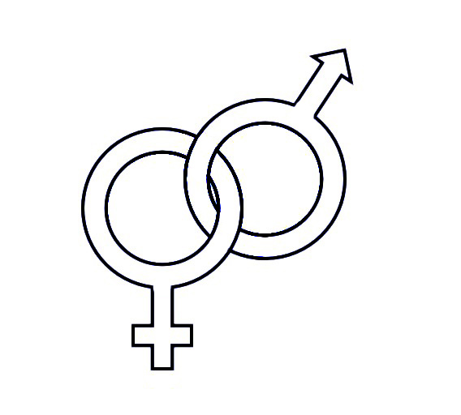

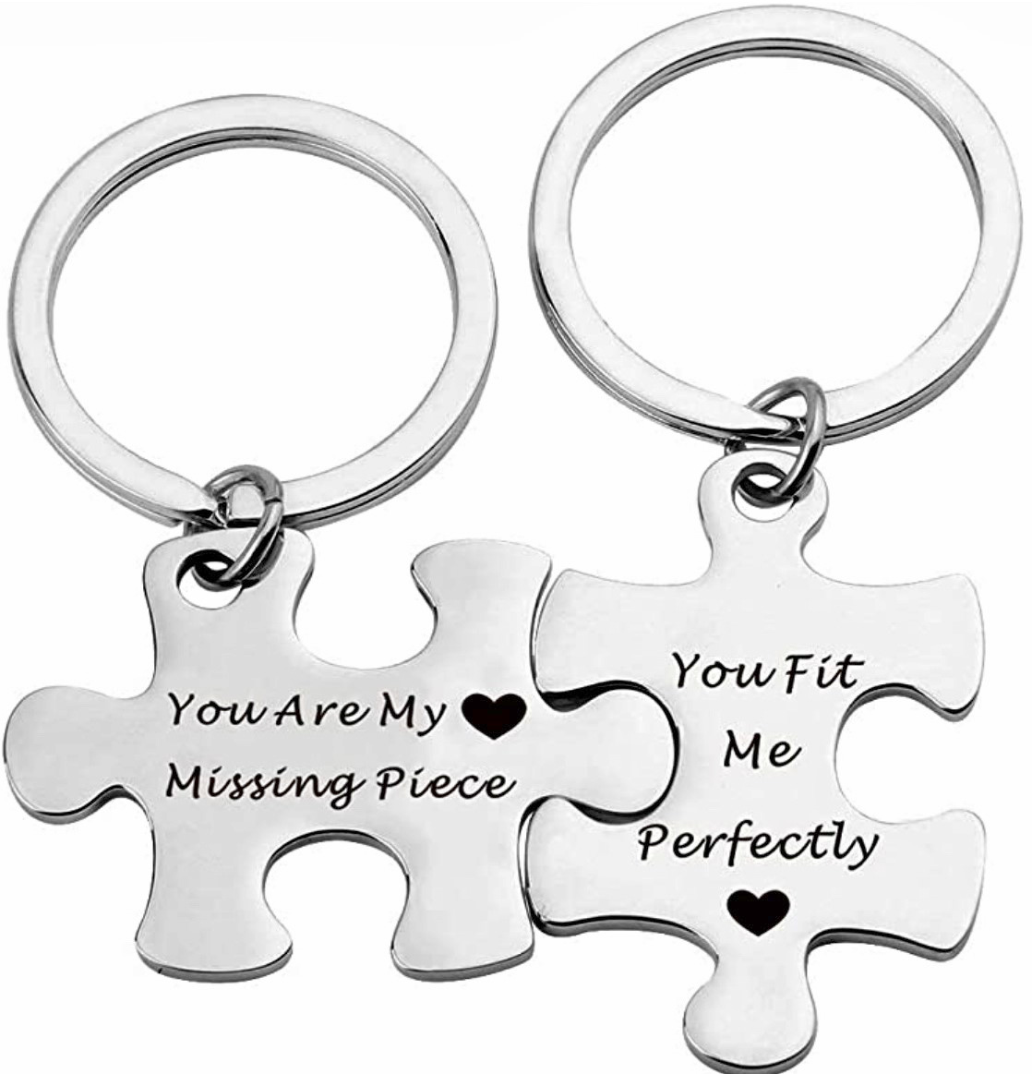
So, What’s a “Help Meet”? (KJV)
She is the Yin to the man’s Yang
She is the Venus to the man’s Mars
She provides balance to the marriage
She is the missing puzzle piece

Slide 14
So, What’s a “Help Meet”? (KJV)
Do most men really believe this?
Do they act like it?
She is the strong, complementary, counterpart helper to the man, so that together, they are a complete whole.
She is the Yin to the man’s Yang
She is the Venus to the man’s Mars
She provides balance to the marriage
She is the missing puzzle piece
Notes:
Do most men act like they really believe this?

Slide 15
The Joy and Frustration of Complementary Natures
“This is one part of the glory of marriage, in the Biblical conception. Two people of different sexes make the commitment and sacrifice that is involved in embracing the other. It is often painful and always complicated, but it helps us grow and mature in ways no other experience can produce, and it brings about deep unity because of the profound complementarity between the sexes...

Slide 16
The Joy and Frustration of Complementary Natures
“Remember, this person is utterly unlike you. He acts differently, thinks differently, and operates differently, and in some cases, dealing with him is not only frustrating and scary, but it’s downright incomprehensible. But at a deeper level, you’re finding out who you really are. You’re seeing him as your other half. You see how God is completing you in your husband. The result of completion is personal ease. Adam and Eve were naked and unashamed with each other before the Fall. There was no anxiety, no hiding. There was a sense of a primordial, ancient unity and accord that Adam and Eve had then that we’ve not experienced since.
- Tim and Kathy Keller. The Meaning of Marriage

Slide 17

Genesis 2: The Garden Paradise Before Sin
The garden was fertile and well-watered, filled with every kind of tree that was beautiful and bore fruit that was good to eat.
Man was placed in the garden to enjoy it while he cared for it, gladly respecting the one restriction given. (Don’t eat of one tree.)
God apparently spent time walking and talking with Adam.
The man enjoyed peace with all the animals and named them as they came to him.
God was attuned to man’s needs and saw that he needed the companionship of a helper suitable for him. (2:18-20)
God made a woman from one of the man’s ribs and brought her to him to be his wife.
Adam responds with joyful poetry, “As last! This one is bone of my bones and flesh of my flesh!”
The man and wife lived together in blissful innocence, free of mistrust, shame, or guilt; living in harmony with God and each other.
Notes:
“At Last” reminds me of the 60’s song by Etta James

Slide 18
Genesis 2: The Garden Paradise Before Sin
Even in paradise, the man’s position of leadership was already established, since he was created and put in charge of the garden first (1 Cor. 11:8-9, 1 Tim. 2:13). His headship can also be inferred from his naming of the woman. However, the relationship between the man and woman in paradise seems to have been a perfect, cooperative partnership of “oneness” free of selfishness and strife.
The man and wife lived together in blissful innocence, free of mistrust, shame, or guilt; living in harmony with God and each other.

